Slide 1
TITLE: ANALYSIS & INSIGHTS
“ANALYZING SALES DATA FOR STRATEGIC DECISION MAKING”

Slide 2



FUTURE INTERNS – SALES ANALYSIS PROJECT
INTRODUCTION
This report focuses on analyzing business sales data to understand revenue trends, product performance, and regional sales distribution. The analysis aims to identify key patterns and generate insights that can support better business decisions.
By examining sales and profit data, the report highlights top-performing products, high-revenue categories, and areas where improvement is needed. This helps in understanding how the business is performing and where it can grow further.

Slide 3

AGENDA
01
Introduction
02
Dataset Overview
03
Sales performance analysis
04
Key insights
05
FUTURE INTERNS – SALES ANALYSIS PROJECT
Recommendation and conclusion

Slide 4
FUTURE INTERNS – SALES ANALYSIS PROJECT
DATASET OVERVIEW
The dataset used for this analysis contains information related to business sales transactions. It includes key fields such as order date, product name, category, region, sales, and profit.
This data helps in understanding sales performance, identifying high-performing products, and analyzing regional trends. It also supports evaluating profitability and making data-driven business decisions.

Slide 5
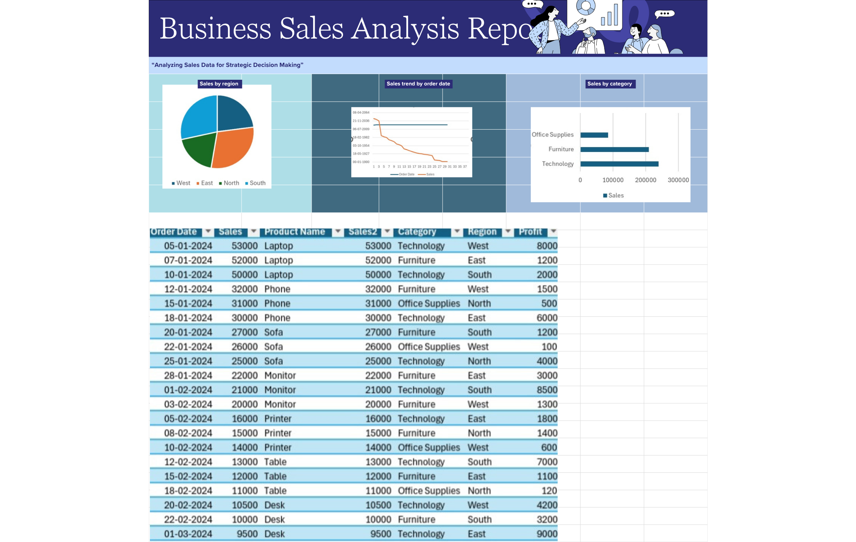

Slide 6
🔹 Sales Trend Analysis
The sales trend analysis shows how revenue changes over time. The data indicates an overall increasing trend in sales, although some fluctuations are observed during certain periods. This suggests that the business is growing, but there are variations in performance that may require better planning and consistency.

Slide 7
🔹 Category Analysis
The category analysis reveals that the Technology category generates the highest revenue compared to Furniture and Office Supplies. This indicates that technology products are the main drivers of business sales, while other categories contribute at a moderate level.

Slide 8
🔹 Regional Analysis
The regional analysis shows that the West region has the highest sales performance among all regions. This suggests strong demand and market presence in that area, while other regions show comparatively lower performance.

Slide 9
🔹 Profit Analysis
The profit analysis highlights that some products generate high sales but relatively lower profit margins. This indicates potential issues in cost management or pricing strategies, suggesting that the business should focus on improving profitability along with increasing sales.

Slide 10

FUTURE INTERNS – SALES ANALYSIS PROJECT
SALES Performance
REVENUE GROWTH
Revenue growth shows how the company’s sales are increasing over time. The analysis indicates a gradual rise in sales with some fluctuations. This reflects overall business growth and increasing demand for products.
MARKET PENETRATION
Market penetration refers to how well the business is performing across different regions and product categories. The analysis shows that the Technology category and West region contribute the highest sales, indicating strong market presence in these areas.
CUSTOMER RETENTION
Customer retention reflects the ability of a business to maintain consistent sales over time. The steady sales trend suggests that customers continue to purchase products, indicating stable demand and customer engagement.

Slide 11
FUTURE INTERNS – SALES ANALYSIS PROJECT
- Sales show an overall increasing trend with some fluctuations over time.
- Technology category generates the highest revenue among all categories.
- West region contributes the most to total sales performance.
- Furniture and Office Supplies have moderate performance compared to Technology
- Some products show high sales but relatively lower profit margins.
KEY INSIGHTS

Slide 12
FUTURE INTERNS – SALES ANALYSIS PROJECT
The business should focus on promoting high-performing products, especially in the Technology category, as it contributes the highest revenue. Expanding operations and marketing efforts in the West region can further improve overall sales performance due to its strong market presence. Additionally, improving strategies for Furniture and Office Supplies categories can help increase their contribution.
It is also important to analyze cost and pricing strategies to improve profit margins, particularly for products with high sales but low profit. Maintaining consistent marketing and sales strategies will support steady and sustainable business growth.
RECOMMENDATION AND CONCLUSION
This analysis provides a clear understanding of business sales performance by highlighting revenue trends, category performance, and regional distribution. It identifies key strengths as well as areas that require improvement.
Overall, the insights and recommendations can help the business make informed decisions, improve profitability, and achieve long-term growth.

